Slide 1


José Ramírez Cabello
December - 2023

Slide 2

Outline
Executive Summary
Introduction
Methodology
Results
Conclusion
Appendix

Slide 3
Executive Summary
Determining the price of each launch, predicting the reuse of the first phase of each rocket, and communicating the results obtained require the execution of various steps and processes
Summary of methodologies
Data collection from 2 sources available on the web
Exploration and analysis (via SQL)
Statistical analysis, data visualization, and categorization of variables for subsequent processes
Construction and evaluation of predictive models
Prepare report and final presentation of the project
Summary of all results
Organized and structured data to meet requirements
Dashboard for review and interactive crossing of variables
Analysis and review of predictive model results
Favorable applicability of a model to solve the proposed problem

Slide 4
Introduction
Project background and context
The Space Y company is planning to join the commercial space services market.
The costs of launching rockets into space vary from USD$62M to more than USD$165M.
The most successful company on the market (Space X) has a two-stage rocket (Falcon 9). The first of them is reusable, with a significant cost reduction.
Space X can sacrifice the first stage rockets depending on some mission parameters (payload, orbit, client). On some occasions due to failures it has not been possible to recover these stage.
Problems you want to find answers
The task entrusted to data scientists is to be able to determine prices for rocket launches by predicting the reuse of the first stage of rockets in future launches.

Slide 5

Section 1

Slide 6
Methodology
Executive Summary
Data collection methodology:
Base information obtained from two different sources:
Obtain rocket and launch information in .json format from Space X API REST (IBM Developer version)
https://cf-courses-data.s3.us.cloud-object-storage.appdomain.cloud/IBM-DS0321EN-SkillsNetwork/datasets/API_call_spacex_api.json
Collect historical records of Falcon 9 launches from a Wikipedia page titled "List of Falcon 9 and Falcon Heavy launches“, updated on 9th June 2021
https://en.wikipedia.org/w/index.php?title=List_of_Falcon_9_and_Falcon_Heavy_launches&oldid=1027686922
Perform data wrangling
Rescue, cleaning and filtering of valuable information available on the web, in html format tables, from falcon 9 rockets, using BeautifulSoup library tools.

Slide 7
Methodology
Executive Summary
Perform exploratory data analysis (EDA) using visualization and SQL
It involves loading .csv data file into database for queries via SQL.
Exploratory analysis of information to evaluate automatic determination of the effective landing rocket first stage.
Perform interactive visual analytics using Folium and Plotly Dash
Detect patterns and perform proximity analysis to choose the optimal launch site.
Perform predictive analysis using classification models
Perform exploratory analysis and structure training data to create a machine learning system to predict whether the first phase of the Falcon 9 rocket will have a successful landing.
Used models: Logistic Regression (lr), support vector machine (svm), Regression tree (tree), K-Nearest Neighbors (KNN)

Slide 8
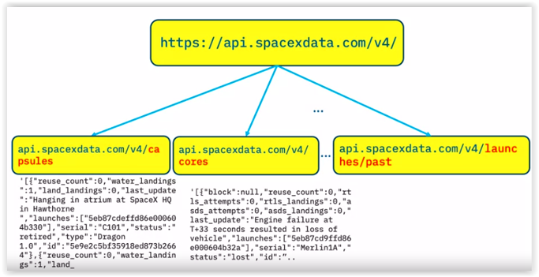
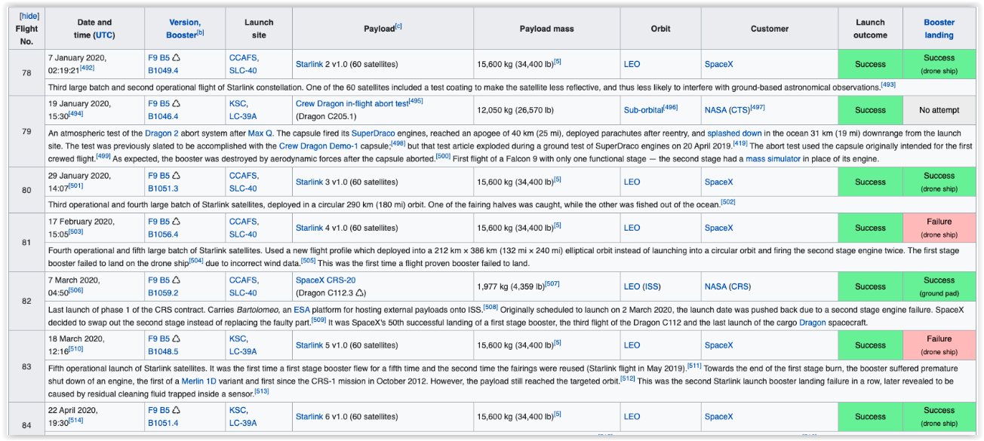

Data Collection
Two sources of input information:
Space X REST API with various rocket launch information, obtained in .json format and converted to a data frame for analysis.
Processing via scraping the Wiki page "Falcon 9 and Falcon Heavy launch list" updated on "June 9, 2021“, to create data structure from tables on website.

Slide 9
Data Collection – SpaceX API
SpaceX API REST launch data from launches/past
Request: using .json format
Parse: Create DataFrame using json_normalize
Extract information via GET Request from /cores
Create a new dataframe adding data on rockets used, landings made, landing locations and conditions.
Filtering process
We replace null values of PayloadMass with the mean of that attribute
We exclude records of the Falcon 1 rocket
Fixing some null values
API Get functions: getBoosterVersion, getLaunchSite, getPayloadData, getCoreData
data_falcon9 = data2[data2['BoosterVersion']!='Falcon 1']
mean = data_falcon9["PayloadMass"].mean()
data_falcon9["PayloadMass"] = data_falcon9["PayloadMass"].replace(np.nan, mean)
Source code: https://github.com/agrofacilchile/SpaceX_capstone_project_jrrc/blob/main/jupyter-labs-spacex-data-collection-api_lab_jrrc.ipynb

Slide 10
Data Collection – Scraping
Extract a Falcon 9 launch records HTML table from Wikipedia
Source: https://en.wikipedia.org/w/index.php?title=List_of_Falcon_9_and_Falcon_Heavy_launches&oldid=1027686922
Python library: BeautifulSoap.
Parse the table and convert it into a Pandas data frame
Extract all column/variable names from the HTML table header.
Save DataFrame into .cvs file
Create a data frame by parsing the launch HTML tables
Request the Falcon9 Launch Wiki page from previous URL
Export DataFrame to file in .cvs format, for use in subsequent processes.
Source code: https://github.com/agrofacilchile/SpaceX_capstone_project_jrrc/blob/main/jupyter-labs-webscraping_lab_jrrc.ipynb

Slide 11
Data Wrangling
Perform exploratory Data Analysis and determine Training Labels
Source: https://cf-courses-data.s3.us.cloud-object-storage.appdomain.cloud/IBM-DS0321EN-SkillsNetwork/datasets/dataset_part_1.csv
Python library: Pandas and Numpy
Data Analysis
Calculate the number and occurrence of each orbit.
Save DataFrame into .cvs file
Calculate the number and occurence of mission outcome of the orbits.
Calculate the number of launches on each site.
Export DataFrame to file in .cvs format, for use in subsequent processes.
Create a landing outcome label from Outcome column.
Source code: https://github.com/agrofacilchile/SpaceX_capstone_project_jrrc/blob/main/labs-jupyter-spacex-Data%20wrangling_lab_jrrc.ipynb

Slide 12
EDA with Data Visualization
Type Chart | Variables | Use descriptions
Scatter point | FlightNumber vs Payload | See how the FlightNumber and Payload variables would affect the launch outcome.
Scatter point | FlightNumber vs LaunchSite | It allows you to relate the number of launches per site and the success rate.
Scatter point | LaunchSite vs Payload | We can observe if there is any relationship between launch sites and their payload mass.
Bar chart | Orbit vs Class | We can visually check if there are any relationship between success rate and orbit type.
Scatter point | Orbit vs FlightNumber | For each orbit, we want to see if there is any relationship between FlightNumber and Orbit type.
Scatter point | Orbit vs Payload | It allows identifying the relationship that may exist between payload and type of orbit.
Line chart | Year vs Average success rate | Allows you to obtain the average launch success trend, considering year and average launch success rate.
Source code: https://github.com/agrofacilchile/SpaceX_capstone_project_jrrc/blob/main/jupyter-labs-eda-dataviz_lab_jrrc.ipynb.jupyterlite.ipynb

Slide 13
EDA with SQL
Understand the Spacex DataSet
Dataset includes a record for each payload carried during a SpaceX mission into outer space.
Load the dataset into the corresponding table in a Db2 database.
Connection with database using sqlite3 and SQL extension
Execute SQL queries to answer different questions:
Names of the unique launch sites in the space mission.
Total payload mass carried by boosters launched by NASA (CRS).
Average payload mass carried by booster version F9 v1.1
Date when the first successful landing outcome in ground pad was achieved
Names of the boosters which have success in drone ship and have payload mass greater than 4000 but less than 6000
Total number of successful and failure mission outcomes
Names of the booster_versions which have carried the maximum payload mass.
List the records which will display the month names, failure landing_outcomes in drone ship ,booster versions, launch_site for months in year 2015.
Ranking the count of landing outcomes (such as Failure or Success) between the date 2010-06-04 and 2017-03-20.
Source code: https://github.com/agrofacilchile/SpaceX_capstone_project_jrrc/blob/main/jupyter-labs-eda-sql-coursera_sqllite_lab_jrrc.ipynb

Slide 14
Build an Interactive Map with Folium
Geographical location of the launch point is important for several factors: Ground rotation speed (best at the equator), Tangential takeoff speed (favorable on the east coast of the USA) and the Safety of the population (near the coast with flight towards the ocean). The launch sites are analyzed considering these elements as success factors:
Mark all launch sites on a map.
Identify the geographical position and determine its distance from the Equator.
Dots on the map identify the position of the launch pads.
Mark the success/failed launches for each site on the map.
Circles and texts identifying the number of launches made on each platform..
Specific symbols identifying success/failure of each launch and platforms.
Calculate the distances between a launch site to its proximities.
Measurement of distances on the map, for critical points identified by geographic coordinates:
Are launch sites in close proximity to railways?
Are launch sites in close proximity to highways?
Are launch sites in close proximity to coastline?
Do launch sites keep certain distance away from cities?
Source code: https://github.com/agrofacilchile/SpaceX_capstone_project_jrrc/blob/main/lab_jupyter_launch_site_location.jupyterlite_lab_jrrc.ipynb

Slide 15
Build a Dashboard with Plotly Dash
Tool that in real time through input components, drop-down lists and sliders allows you to perform interactive visual analyzes that allow you to determine:
Which site has the most successful releases?
Which site has the highest launch success rate?
Which payload range(s) has the highest launch success rate?
Which payload range(s) has the lowest launch success rate?
Which version of F9 Booster has the highest launch success rate?
Features incorporated into the dashboard:.
launch site entry (selection/deployment) component
representation via pie chart of launch success (according to drop-down menu of the selected site)
slider using ranges to select payload
successful payload scatterplot
Source code: https://github.com/agrofacilchile/SpaceX_capstone_project_jrrc/blob/main/spacex_dash_app_jrrc.py

Slide 16
Predictive Analysis (Classification)
Process to standardize data, divide it into training and test groups, to train the models and through hyperparameters determine which ones work best.
The models are: linear regression (lr), support vector machine (SVM), decision tree (tree) and k nearest neighbor (KNN).
Process flowchart:
Load dataframe
Split data: training data (80%) and test data (20%).
Function used: train_test_split, with test_size=0.2, and random_state=2).
Find the method performs best, using test data
Standardize data
Split: training data and test data
Two data file: dataset_part_2.csv - dataset_part_3.csv.
Function to change vectors into a better representation for later estimators.
preprocessing.StandardScaler().fit(X).transform(X).
Evaluated method byGridSearchCV : lr, SVM, tree and KNN.
Criteria: validation accuracy (best_score_), accuracy on test data(.score), and plot confusion matrix(plot_confusion_matrix).
Create a NumPy array (Class column).
Source code: https://github.com/agrofacilchile/SpaceX_capstone_project_jrrc/blob/main/SpaceX_Machine_Learning_Prediction_Part_5_jrrc_v3.jupyterlite.ipynb

Slide 17
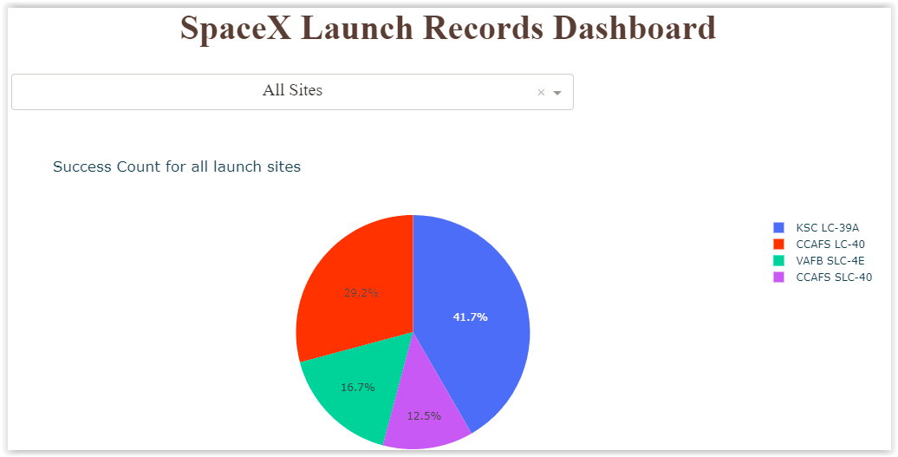
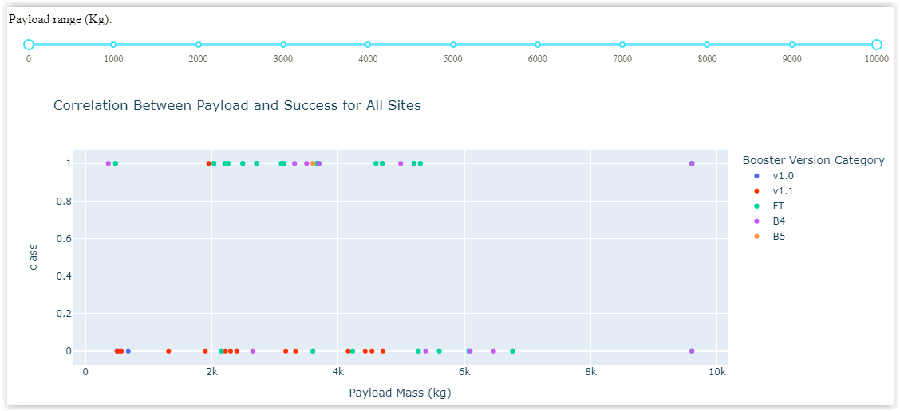
Results
Exploratory data analysis results
The success rate of rocket launches is improving over time.
By increasing the flight number, the landing success rate of the first stage also improves.
The KSC LC-39A platform shows the highest success rate among landing sites.
A good ratio of successful landings of the first stage is observed, with payload masses around 7000 kg.
As experience in rocket launches increases, the success rate of rocket launches also increases when planning to recover the first stage.
Predictive analysis results
The decision tree model (tree) shows better quality parameters as a predictive model for the data set.
Interactive analytics demo in screenshots

Slide 18

Section 2

Slide 19
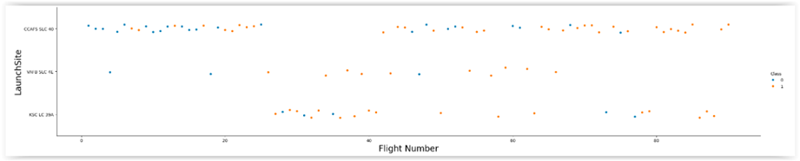
Flight Number vs. Launch Site
There is a clear positive progression in the success rate of launches, as the number of flights carried out increases.
There is a significant concentration of flight launches from the CCAFS SCL-40 platform.
The VAFB SLC-4E launch pad does not record flights in the last recorded period.

Slide 20
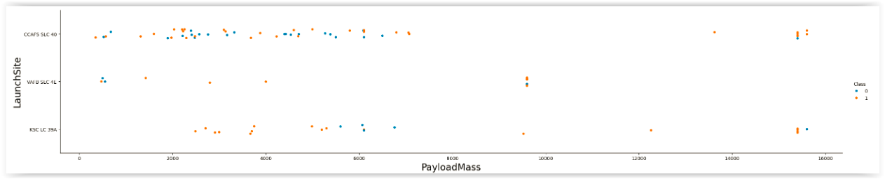
Payload vs. Launch Site
Above 7000 kg load, the success rate is high.
About 20000 kg. there are only launches from the CCAFS SCL-40 and KSC CL-39A platforms. Each one records only one unsuccessful case.
The CCAFS SCL-40 platform is the one that concentrates the greatest number of launches under 7000 kg. In this range, a significant rate of failed recovery is observed.

Slide 21
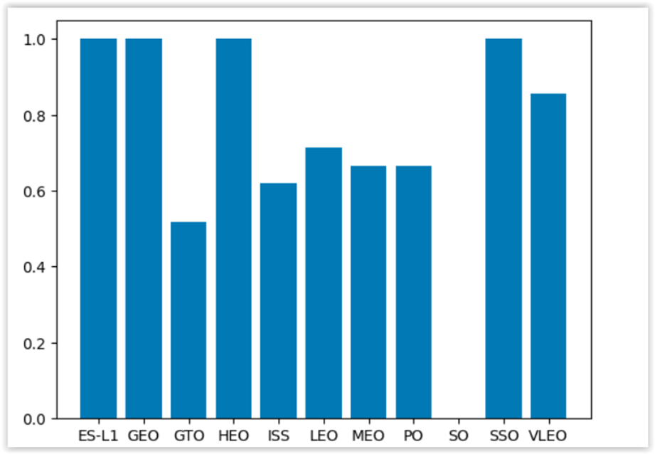
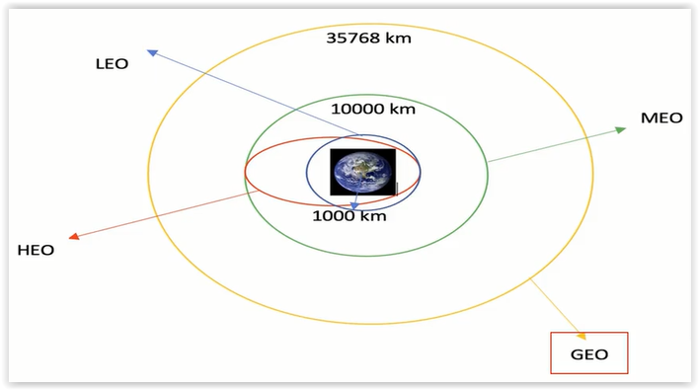
Success Rate vs. Orbit Type
The orbits that show the maximum success rate are:
Stationary satellite orbit at Lagrange point 1 (ES-L1)
Geostationary orbit (GEO)
Highly elliptical orbit (HEO)
Helisynchronous orbit (SSO)

Slide 22
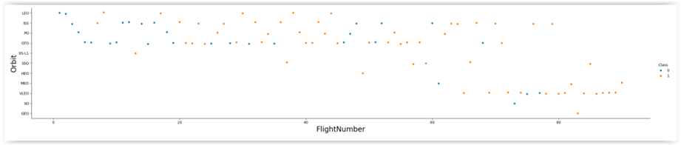
Flight Number vs. Orbit Type
The FlightNumber carried out are concentrated in 5 orbits:
Low Earth Orbit (LEO)
International Space Station (ISS)
Polar orbit (PO)
Geostationary Transfer Orbit (GTO)
Very Low Earth Orbit (VLEO)
Success rate increases noticeably when the flight number is greater.

Slide 23
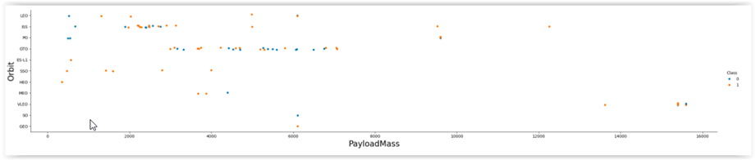
Payload vs. Orbit Type
Launches with payload exceeding 13,000 kg., they are associated with very low Earth orbit (VLEO), and their success rate is high.
Most of the payload is below 8,000 kg, and is distributed as follows:
In the orbit of the International Space Station (ISS), loads between 2,000 and 3,000 kg are preferably placed, with a success rate that exceeds 70%.
n the Geostationary Transfer Orbit (GTO), rockets with a payload between 3,000 and 7,000 kg are sent, presenting an exit rate slightly higher than 50%.

Slide 24
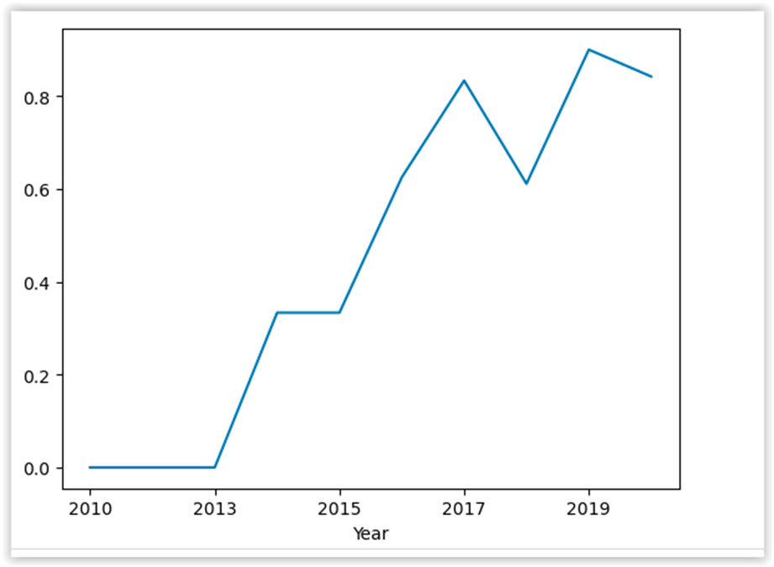
Launch Success Yearly Trend
The annual success rate shows a significant progression from 2010 (rate = 0.0) to 2020 (rate over 0.8).
The main features are:
Rate stagnant at 0.0 in the period between 2010 and 2013.
Sustained rate in 2014 and 2015 (rate close to 0.35).
Progressive increase in the rate between 2015 and 2019 (rate above 0.8), with two decreases in the progression in 2018 and 2020, but the rate remains above 0.8.

Slide 25
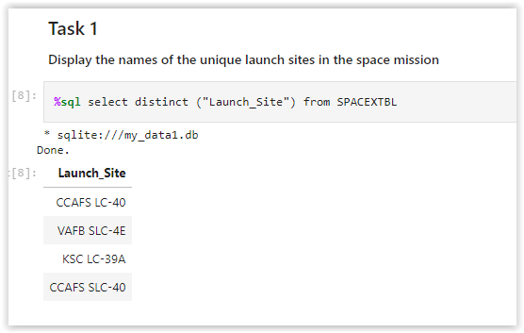
All Launch Site Names
SQL query to retrieve unique names of rocket launch sites.
Key: Use the distinct clause to get unique values for the name of launch sites.
Allows you to identify 4 different launch sites:
CCAFS LC-40
VAFB SCL-4E
KSC LC-39A
CCAFS SLC-40

Slide 26
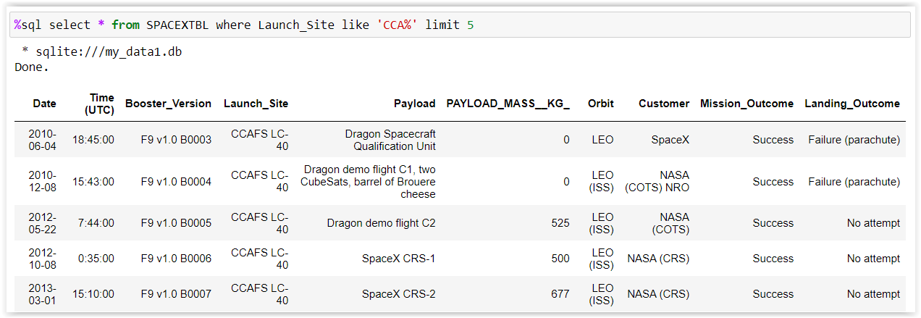
Launch Site Names Begin with 'CCA'
Find 5 records where launch sites begin with `CCA`
Key: Use of the limit 5 clause to rescue the first 5 records from database.

Slide 27
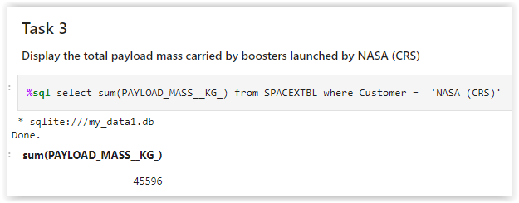
Total Payload Mass
Calculate the total payload carried by boosters from NASA
Keys: Use of sum() function to add payload and the where clause to select only records from NASA (CRS) customer.
Result: 45596 kg.

Slide 28
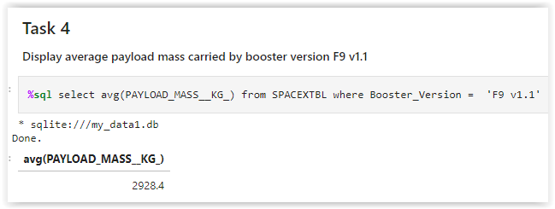
Average Payload Mass by F9 v1.1
Calculate the average payload mass carried by booster version F9 v1.1
Keys: Use of avg() function to calculate the average weight of payload, and the where clause to select only records from booster version F9 v1.1
Result: 2928,4 kg.

Slide 29
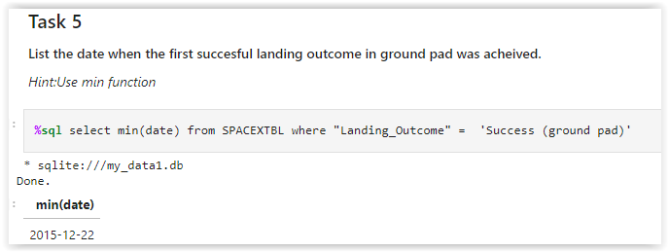
First Successful Ground Landing Date
Find the dates of the first successful landing outcome on ground pad
Keys: Use of min() function to obtain the smallest value of date attribute, and where clause to select only records of successful landings on the terrestrial platform.
Result: date is 2015-12-22.

Slide 30
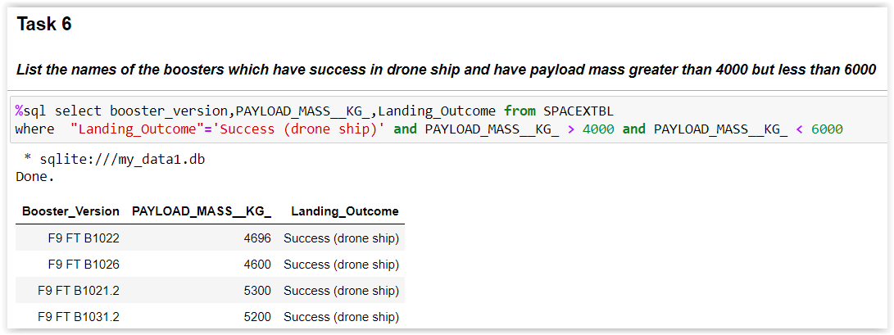
Successful Drone Ship Landing with Payload between 4000 and 6000
List the names of boosters which have successfully landed on drone ship and had payload mass greater than 4000 but less than 6000
Keys: Use of the select clauses for selection and where for filtering. Where clause uses and conditions, equal (=), greater than (>) and less than (<).
Result: 4 boosters met the indicated specifications.

Slide 31
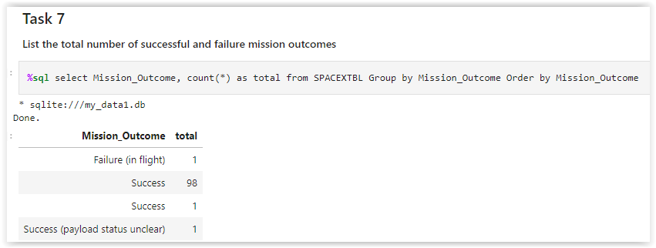
Total Number of Successful and Failure Mission Outcomes
Calculate the total number of successful and failure mission outcomes
Keys: Combines several actions on the Mission_Outcome attribute: select clauses for selection, count() function to determine occurrences, group by clause for grouping and order by clause for record ordering.
Result: 101 records grouped into 4 classes according to values of Mission_outcome attribute.

Slide 32
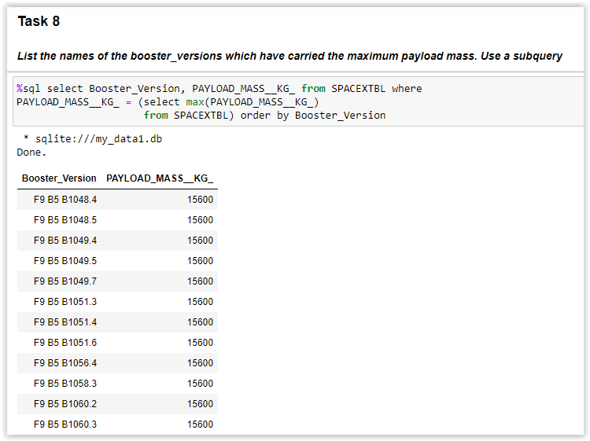
Boosters Carried Maximum Payload
List the names of the booster which have carried the maximum payload mass
Keys: The information is obtained through query and subquery, combining select, where and order by clauses, integrated with max() function.
Result: Shows a list with 12 boosters name that have transported the maximum payload registered in the database (15600 kg).

Slide 33
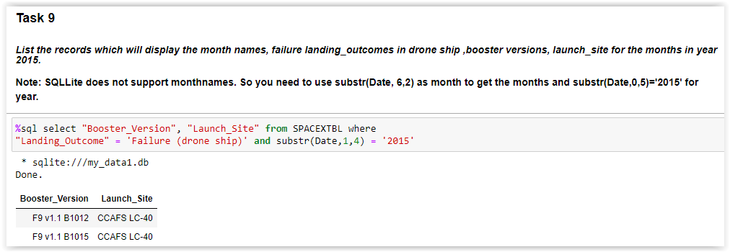
2015 Launch Records
List the failed landing_outcomes in drone ship, their booster versions, and launch site names for in year 2015
Query uses select and where clauses combined with substr() function, to obtain the requested information.
Result: Shows failed drone landings from 2015, identifying 2 boosters at the CCAFS LC-40 launch site.

Slide 34
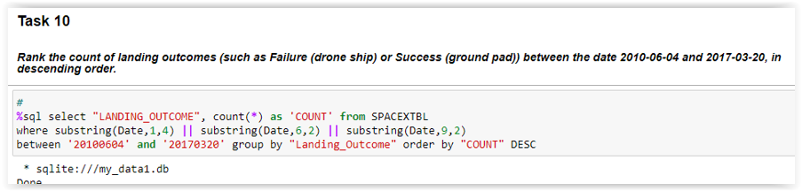
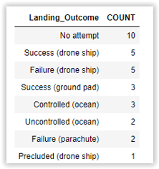
Rank Landing Outcomes Between 2010-06-04 and 2017-03-20
Rank the count of landing outcomes (such as Failure (drone ship) or Success (ground pad)) between the date 2010-06-04 and 2017-03-20, in descending order
Complex query that combines clauses (select, where, between, group by, order by and DESC), with functions (count() and substring()), plus logical connector and.
Result: Displays a list with 8 types of landing results and 31 observed cases for time period indicated in the query.

Slide 35

Section 3

Slide 36
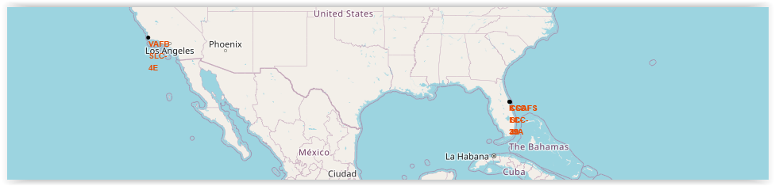
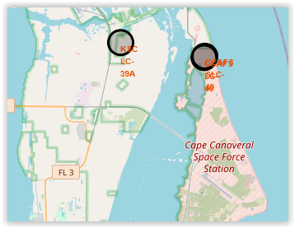
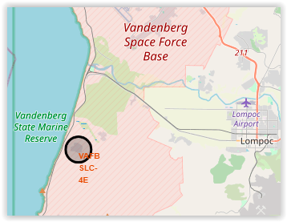
Folium Map: Launch Sites Locations
There are facilities near the Pacific and Atlantic coasts.
The Atlantic shelves are located closer to the Equator.
Launches from the Atlantic coast allow us to meet better safety standards.

Slide 37

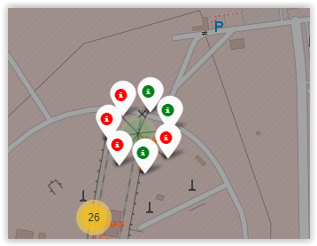
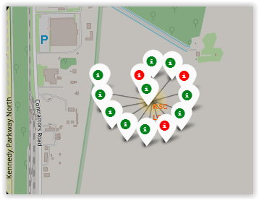
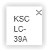
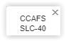
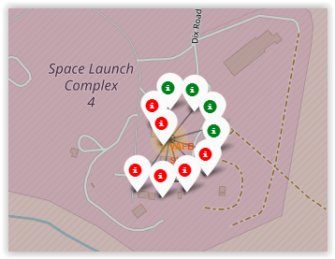
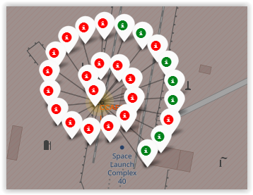
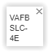
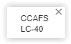
Folium Map: Launch outcomes for each site
Total launches pads analyzed: 56
Successful 24 (green symbol)
Unsuccessful 32 (red symbol)
West Coast: one launch pads
VAFB SCL-4E: 10 launches, 4 successful
East Coast: 3 launch pads, 46 launches, 20 successful
KSC LC-39A: 13 launches, 10 successful
CCAFS LC-40: 26 launches, 7 successful
CCAFS SCL-40: 7 launches, 3 successful

Slide 38
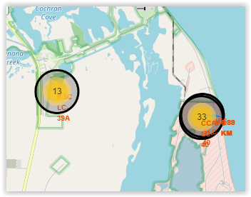
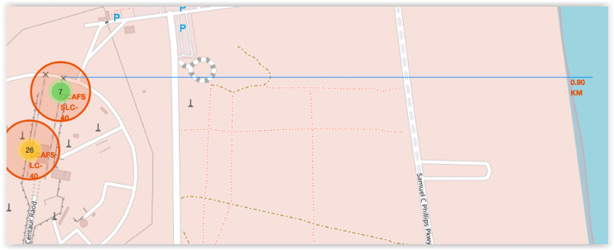
Folium Map: Security and mobility around a launch pad
The territorial proximity to transportation infrastructure (railways, highways) or to geographic locations due to security criteria (coastline, cities) are important factors in the analysis of the work carried out.
As an example, the distance from the CCAFS SCL-40 launch platform to 4 specific geographical points was calculated:
Coastline: 0.88 km. (blue line on the map)
Nearest city (Titusville): 23.73 km
Most railway line (Railway NASA): 1.06 km
Nearest highway (Highway FL405): 7.50 km

Slide 39

Section 4

Slide 40
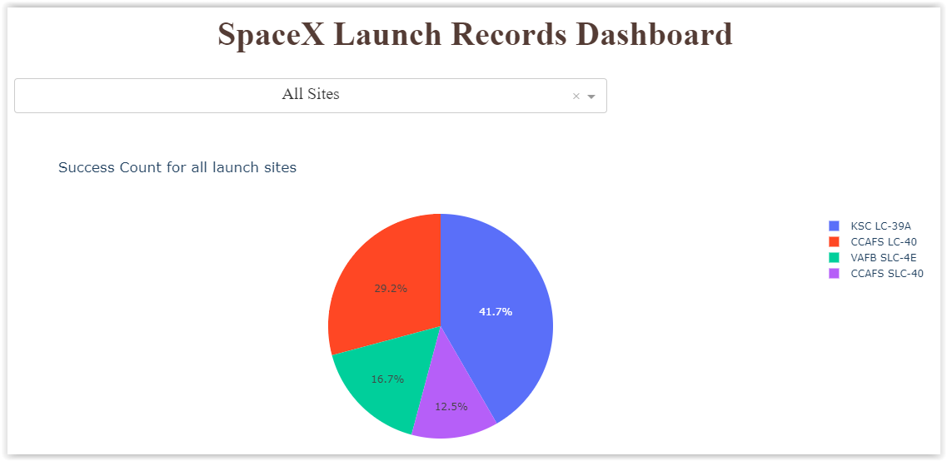
Dashboard: Dropdown list panel - global information
The drop-down panel allows you to analyze the information for each launch site, or all of them together.
When the global information (all sites) is reviewed in the drop-down panel, pie chart displays the percentage share of each launch site in the total successful landings.
The pie chart shows that KSC LC-39A platform has the best rate, with 41.7% of successful landings, while CCAFS LC-40 platform only accounts for 12.5% of successful landings.

Slide 41
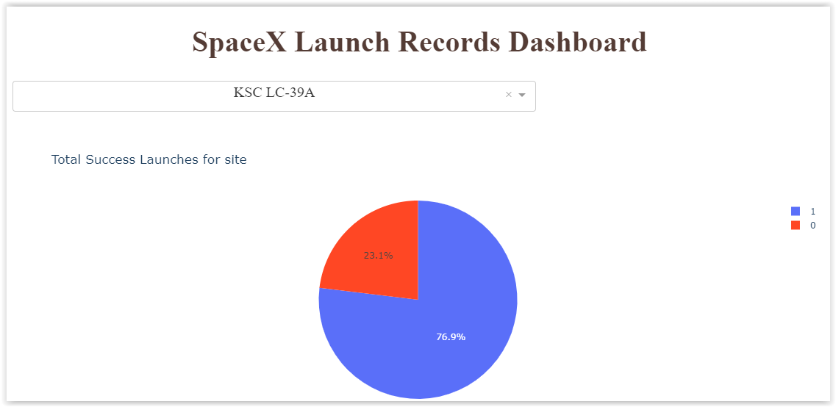
Dashboard: Dropdown list panel - launch platform information
When a launch pad is identified in the drop-down panel, the pie chart displays the successful landing rate (blue color) and unsuccessful landing rate (red color).
The pie chart shows that on the KSC LC-39A platform, 76.9% of landings have been successful, and only 23.1% of them have been unsuccessful.

Slide 42
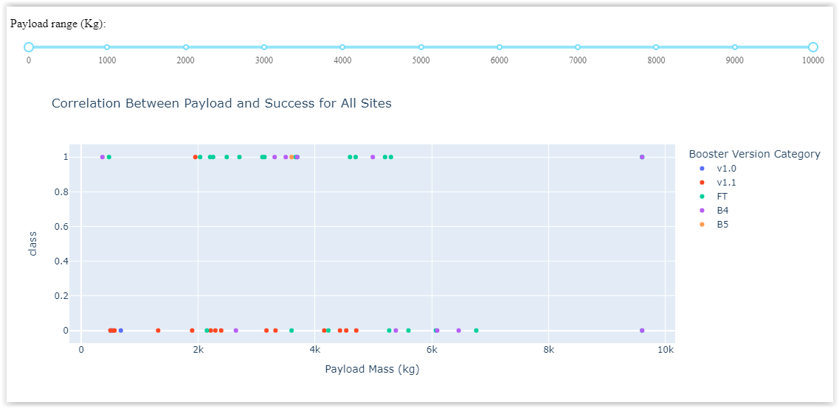
Dashboard: Range slider
A range slider is used to define search criteria by payload and relate it to drive model used.
The dot scatter plot shows a successful (class=1) or failed (class=0) point using a different color for each booster category (5), located into space according to payload transported.
For example, the boosters model FT has 12 successful landings with loads between 0 and 6000 kg, and also records 6 failed landings with loads between 2000 and 7000 kg.

Slide 43
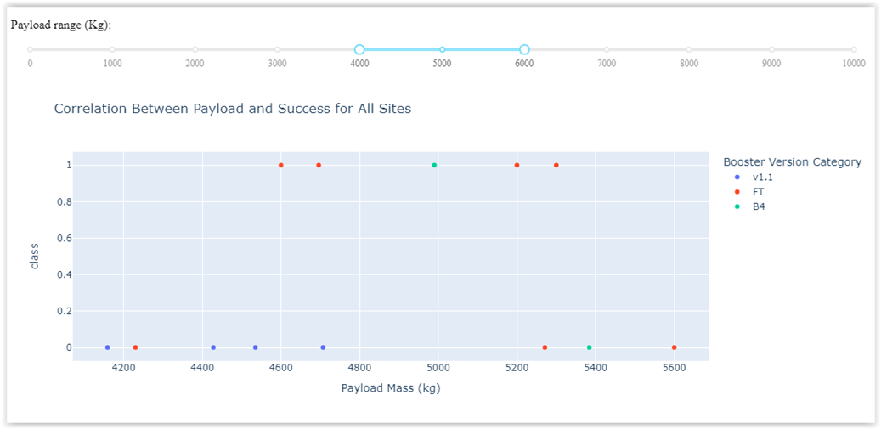
Dashboard: Range slider
This example shows the distribution when adjusting the payload range between 4000 and 6000 kg.
It is shown that only 3 booster models were used for this range of payloads.
Only two booster models record successful landings: FT and B4.

Slide 44

Section 5

Slide 45
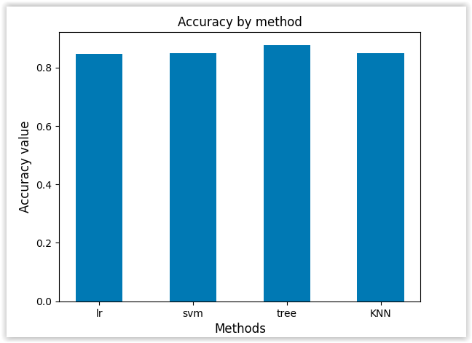
Classification Accuracy
The percentage of observations correctly classified with respect to the total predictions shows an accuracy greater than 0.84 for each model evaluated:
Logistic Regression (lr)
support vector machine (svm)
Regression tree (tree)
K-Nearest Neighbors (KNN)
The model that obtains the best results is Tree, with an accuracy of 0.8767

Slide 46
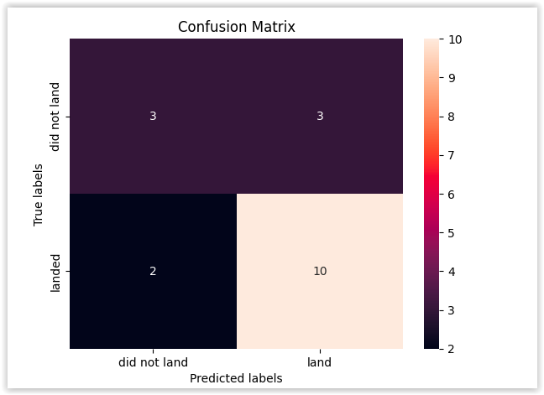
Confusion Matrix
The confusion matrix for the prediction made with the xtree regression model, on 18 observations, shows the following results:
10 true positives (well-classified successful landings)
3 true negatives (well-classified failed landings)
3 false positives (failed landings but classified as successful)
2 false negatives (successful landings but classified as failed)

Slide 47
Conclusions
Successful landings present significant and progressive improvement over time.
A range is identified (2000 to 6000 kg) where successful landings have a greater positive rate.
The prediction methods used show good levels of accuracy, and their confusion matrices yield similar results.
The decision tree method (tree) is the one that obtains the best accuracy results, reaching 0.8767 in the training test data.
It is possible to recommend the use of this model (tree) to Space Y to decide its entry into the space travel market.

Slide 48
Appendix
Include any relevant assets like Python code snippets, SQL queries, charts, Notebook outputs, or data sets that you may have created during this project

Slide 49


